Slide 1
React

Slide 2
What is it?
Declarative
Flexible
Composable
Consistency
Notes:
React is JavaScript library that uses the idea of components to create User interfaces. Its extremely to use with a very small API. Its declarative, Flexible, and allows for consistent design.

Slide 3
First Impressions
Notes:
Show button.js and comment on the return syntax: JSX and the props. Regarding separation of concern, HMTL and JavaScript are within the same file, and sometimes CSS is in the same file. Comment how this will be addressed differently.

Slide 4
Fundamentals

Slide 5
Everything is a Component
Notes:
Everything in React is a component, all components are defined the same way and share the same lifecycle APIs.

Slide 6
React has no…
controllers
directives
templates
global event listeners
models
no view models
Notes:
React is very different from our MVC or basic User interface building patterns from the past. React only has components, and nothing else.

Slide 7
Separation of Components
Notes:
React Applications are built of a bunch of components talking to each other and passing data around. The idea is to create unique user interfaces for each part of your app and combine them together. The separation is not related to source code files such as html and javascript in separate files, but rather your UI separated into different building blocks. This makes it more composable, reusable and really easy to test. Show todo list component.

Slide 8
Data Flow
Notes:
React has no data communication framework built in, for example Angular has 2 way data binding using the $digest loop. React has data flow from component to component, meaning that data flows from a parent component to its children via an object called props.

Slide 9
Props
Notes:
Props are immutable, meaning that the children can’t change the value being passed down that may cause side effects within the parent. (Show props within list.js). If you want to modify children props, you pass down the parents state.

Slide 10
State
Notes:
state is mutable by the component. You pass state down as a props (once state is passed down via props it becomes immutable, available within the props object), or use it to track the components own internal UI and sometimes data state. Essentially every time state changes, it fires the render method allowing react to update the view according to the state. (show top level app layer)

Slide 11
Render
Notes:
Render is a function defined by the developer on how the components contents will be positioned and how props and state will effect the components behaviour. Render is fired every time a prop is updated (new props are passed in) or state is changed. React’s biggest advantage is the virtual DOM, render will fire and return DOM elements which will be compared against a virtual DOM (in memory representation) and only update the changes!

Slide 12
Many others…
constructor
componentWillMount
componentDidMount
componentWillReceiveProps()
shouldComponentUpdate()
componentWillUpdate()
componentDidUpdate()
Notes:
Tons of other lifecycle methods

Slide 13
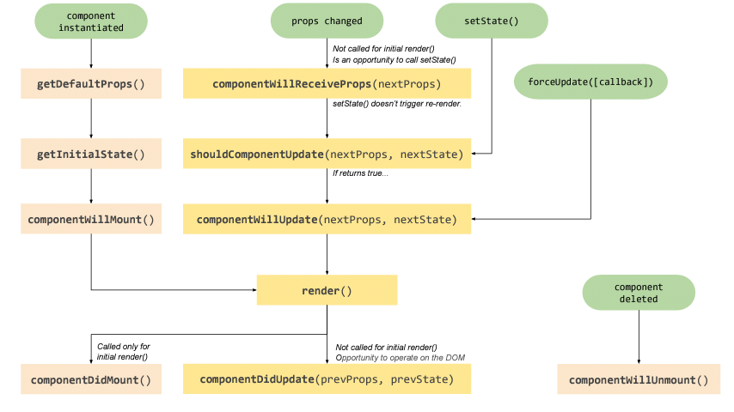
Notes:
How the lifecycle methods are triggered through out the components initial to last render.

Slide 14
Live Demo
Notes:
Complete the add button action to add entries to the list as the live demo.

Slide 15
Questions

Slide 16
Follow me
github.com/awaseem
aliwaseem.com

